Slide 1
Jermyn Borough Council Meeting
9/15/22

Slide 2
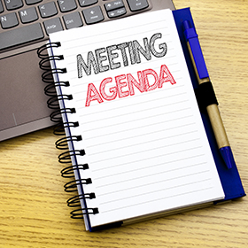
Meeting Agenda
September 15, 2022
CALL TO ORDER
PLEDGE OF ALLEGIANCE
ROLL CALL
PREVIOUS MEETING MINUTES
TREASURER REPORT/BILLS PAYABLE
CORRESPONDENCE
PUBLIC COMMENT
NOR LACK PLANNING MARY LIZ DONATO
VACANCY ON COUNCIL
PROFESSIONAL REPORTS
POLICE
FIRE
EMA
SOLICITOR
CODE ENFORCEMENT
ZONING
ENGINEER
TAX COLLECTOR
MAYOR
COMMITTEE REPORTS
WASH AVE ISSUES (423-25, 427)
COMCAST UPDATE
500 BLOCK OF MELLOW CT
DWIGHT AVE PAVING
DPW BUILDING FLOOR GRANT
INSURANCE QUOTE INFORMATION
REGIONAL POLICE SEMINAR REMINDER (9/26 2-4 OR 6-8)
LSA GRANT REQUEST RESOLUTIONS
CHICKEN ORDINANCE UPDATE
GARBAGE CONTRACT
NEW BUSINESS

Slide 3
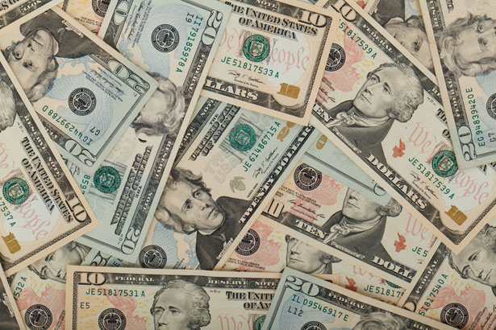
Treasurer’s report
9/15/22
ASSETS
Checking/Savings
Capital Reserve - DPW 10,727.00
Capital Reserve - Police 4,801.82
Crime Watch Fund 222.69
General Fund - Community 243,454.46
General Fund - FNB 5,838.39
Holiday Lights Fund 1,374.09

Slide 4
Treasurer’s report
Investment - General Fund 1,004.51
Investment - Liquid Fuels 33,914.99
Investment - Paving Fund 1,014.94
Investment - Recycling 5,018.35
Investment - Refuse 2,607.98
Liquid Fuels - FNB 39,246.98
Petty Cash 231.00
Recreations Fund 21,662.34
Recycling - Community 10,912.28
Refuse Checking - FNB 89,682.17
Total Checking/Savings 471,713.99

Slide 5
Treasurer’s report
200000 · Accounts Payable 6,190.87
Long Term Debt 245,818.13

Slide 6
MS4 Minute
https://youtu.be/lwRTJyG8SZI

Slide 7


